Slide 1
CSW
Computer Science Writing
Lecture 1
Stefano Pirandola
(Based on a 2009 lecture by Steve King)

Slide 2
Aims
Immediate aims:
To help prepare for your project work
  Planning your project
  Planning your project report
  Structuring the overall write up, how to do a literature review
  Prepare for project presentation
Longer terms aims:
Being prepared on how to plan work, write reports, make presentations in your future work

Slide 3
Learning outcomes for the course
To be able to use text preparation facilities to present written text, clearly and accurately
To be able to plan and execute an extended piece of writing – how to structure it, write it
To be able to use literature effectively, including appropriate citation styles and constructing a critique
To prepare and give a presentation on an academic subject, in a fixed time

Slide 4
Who’s here, doing what?
All 3Y0s (MEng) and MSc NCs:
  Attend lectures and problem classes / practicals
  Open assessment (lit review - 2 stages; due spr/3)
  Give presentation (on aspect of lit review, spr/4)
All the other students (on CS projects, PR3/4):
  Attend lectures and problem classes / practicals
  Presentation (mark does not count, but detailed feedback will be given, good practice for project presentation)

Slide 5
Comments – on the open assessment
The guidelines are very precise
Divergence is heavily penalised
Read the guidance material and follow it

Slide 6
Lectures
10 lectures:
Week 1: Friday 15th October, 11:15, LMB/031
Weeks 2, 3 and 4 (3 lectures per week):
  Thursdays, 9:15 and 14:15, LMB/002A
  Fridays, 11:15, LMB/031
Exception: Week 3 Thursday, 14:15, lecture in CSE/270
Whatever course you’re on, you should (!) attend the lectures

Slide 7
“Guest” lectures
Scientific method & Stats and graphs
  Susan Stepney, 2/th/9.15 and 14.15
Preparing a project report using LaTeX
  Jeremy Jacob, 2/f/11.15
Ethics and student projects
  Alistair Edwards, 3/th/9.15
Turnitin
  ASO, 3/th/14.15
Online literature resources
  Tony Wilson (Library), 3/f/11.15
Check the full lecture timetable on the website!

Slide 8
‘Practicals’ & Presentations
Tuesday weeks 3-4 only:
CSE/069&070, time 10.15 or 12.15
Week 3: optional exercise sheet on LaTeX
Week 4: mandatory session on online lit resources
Week 5 of Term - Presentations by PR3/4 students

Slide 9
Presentations II
Group of 8 students for a 50 minute session plus me and a demonstrator:
  5 minute presentation each
  Timing strictly enforced
  A couple of questions from me, demo or fellow student
Powerpoint (or equivalent) presentation - to be submitted 24 hours in advance, so I can load them all on a computer, check they run
You may wish to give us a hand-out (to be discussed in the session on giving presentations)

Slide 10
Presentations III
Topics for presentations (more details later):
For PR3/4 students - one or two key papers from your project literature review, a critical analysis of these paper/s
For all other students (MEng and MScNC) - instructions on choosing topic and papers will be provided as part of the open assessment

Slide 11
What is a project ?
Demonstrates your ability to conduct a sustained piece of work, use computer science techniques, following …
An appropriate development lifecycle
Usually:
  Requirements - design - implementation - evaluation (don’t forget evaluation!) - maintenance
  Including producing some kind of “artifact” - software, hardware, training materials …
BSc projects do not need to “increase knowledge”, MSc/MEng projects do

Slide 12
Projects and Knowledge
KNOWLEDGE
PR3
MEng
After Dawson, 1999

Slide 13
Methods for projects
Different methods are appropriate for different projects:
  Software Engineering methods - agile programming, RAD, unified process etc
  Hardware methods for specification/design
  Research method: problem-hypothesis-experiment
  Algorithm design/proof: problem-plan-do

Slide 14
Method is very important
In your project report, you need to justify why you chose particular methods - so think about this at the beginning, as you go along
What alternatives are available to you?
Discuss with your supervisor if necessary
No-one expects you to be able to use a method perfectly the first time - you will make mistakes
Turn that to your advantage in the write up

Slide 15
Using method …
Very useful to be able to write about:
  what you learnt about the method from doing the project
  what went wrong
  what you would do differently another time
  What the inherent limitations about the method are
Take notes as you go along, you won’t remember all the problems, hassles, interesting things at the end
Keep a project notebook, blog ….

Slide 16
Fitting a Project to a Lifecycle
Design-and-build projects should fit easily
Other projects:
  Explain the goals, constraints, givens, literature
  Write up the method: hypothesis, experimental design, plan etc
  Write up and evaluate the results
  Consider what maintenance might mean!

Slide 17
And MEng/MSc NC Projects…
All the above apply
More thoughtful and advanced in approach and content….
  Systematic, comprehensive understanding
  Critical awareness and evaluation
  Forefront of the field; original knowledge or application

Slide 18

Initial planning for a project
Who has used a Gantt chart?
Not an acronym: Mr. Henry Gantt, mechanical engineer, developed the diagrams for the Hoover dam and other big projects
Can do one manually with spreadsheet programs (Excel), or with nice automatic features

Slide 19
Gantt charts
Need:
Tasks (for a complex project, might group the tasks into work packages with related tasks
Milestones - key points when things will be achieved (e.g. “agree title with supervisor”)
Deliverables - artifacts and components of artifacts to be produced - components of software, chapters/drafts of report

Slide 20
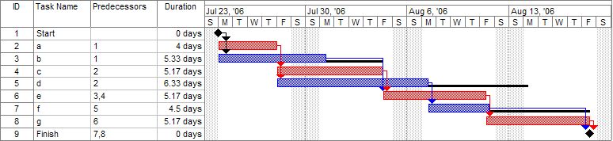
Gantt charts
Example from Wikipedia
http://en.wikipedia.org/wiki/Gantt_chart

Slide 21
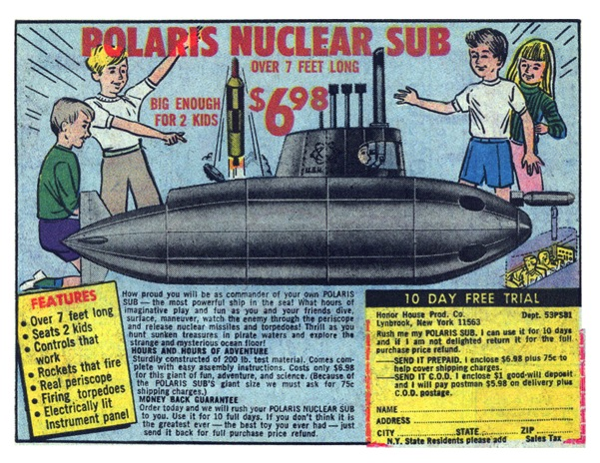
Pert charts
First developed to support the U.S. Navy's Polaris nuclear submarine project (1957)
www.comixstuff.com

Slide 22
Pert charts
More complex than a Gantt
Network diagram: some things can be done in parallel, some things must start after other...
If you want to get really sophisticated, can do a critical path analysis

Slide 23
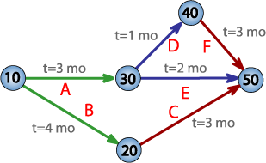
Pert charts
PERT = Project Evaluation and Review Technique
A, B, C … are the tasks/activities
t = 3 mo … time needed to complete the activity
10, 20, … are the milestones
Critical Path = the longest possible continuous pathway taken from the initial event to the terminal event. It determines the total time required for the project.
http://en.wikipedia.org/wiki/Program_Evaluation_and_Review_Technique
Critical path = 7 months

Slide 24
Do a Gantt for your project
Doing your first Gantt can be very daunting- knowing how long things will take is a stab in the dark
A stab in the dark is better than nothing
Have a go, be realistic, put in time for Christmas, exams, open assessments etc
Make your supervisor do some work - ask for feedback on the feasibility of the first Gantt

Slide 25
Make your Gantt work for you!
Do use the Gantt chart during the project
It’s not the end of the world if you go a bit off the rails
But then re-work the Gantt
Don’t be afraid of discussing adjustments with your supervisor - get their opinion on the best course of action

Slide 26
But keep your first Gantt
Make notes on why/how you misjudged things
This can be useful in your write up
But will also help you be more realistic when you start work (or continue further study) and need to do planning exercises again

Slide 27
Gantt and PERT resources
More resources on Gantt and PERT charts are on the web page

